Slide 1
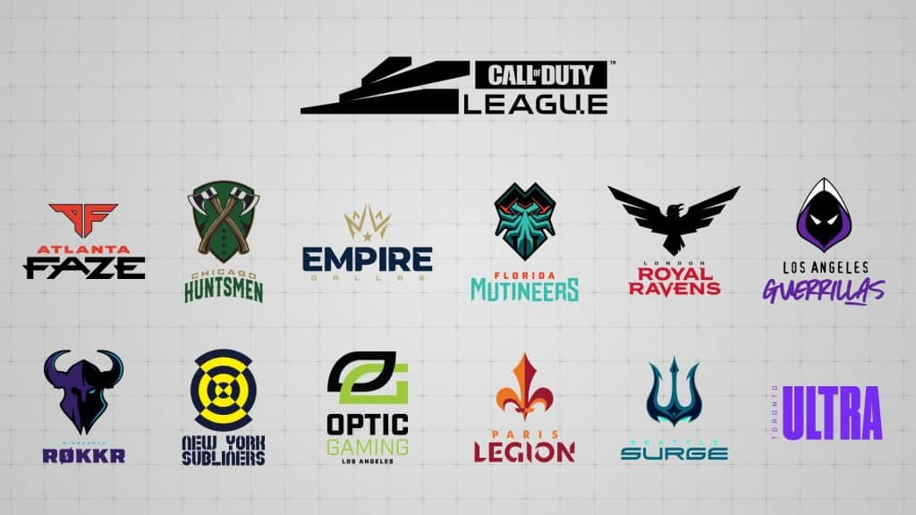

E-Sports
Call of Duty League
Alonso Gallegos
Hult International Business School

Slide 2
The league wants to add a new team:” Cleveland Fire,” to the already 13 existent groups on the league
As a result, we will provide some insights of the analysis on the most commented teams and what actions should we take to introduce the new group and create a big impact on social media.
Objectives
First objective is to explore the tweet social media presence related to the league and the teams.
For the analysis we will perform two kinds:
Word frequency and related conversations topic referencing warzone or gaming slang.
Sentiment Analysis

Slide 3
Considerations and Limitations
We are using the student_TeamTimeline database contained on:
setwd("~/Documents/MBAN/R/hult_NLP_student/cases/Call of Duty E-Sport/teamTimeline")
Since this is a database containing nearly 27k tweets, we will take a simple random sample of 3600 tweets to explore the data due to processing constraints.
The emojis were replace by words therefore instead of having 😃 it is been replace by the word smiling face
We will explore on detail these teams:
Toronto Ultra (second biggest quantity of tweets)
Atlanta Rokkrs (biggest queantity of tweets)
Immortals (biggest quantity of followers).
Some words may have been omitted since we do not have a complete dictionary of gaming related words

Slide 4

Exploring word frequency and conversation topics

Slide 5
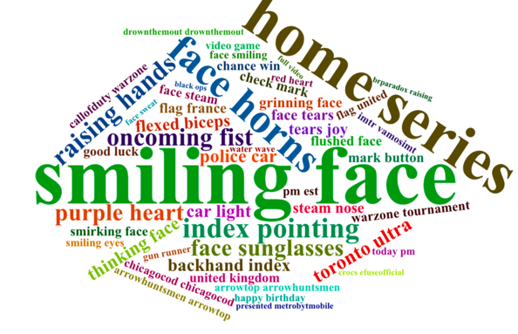
Bigram Word cloud
Word cloud from the original sample, containing all the teams
Most common word:
Smiling face
home series
Face horns
Gaming words:
Warzone
Mark button
Team nicknames
Drownthemout

Slide 6
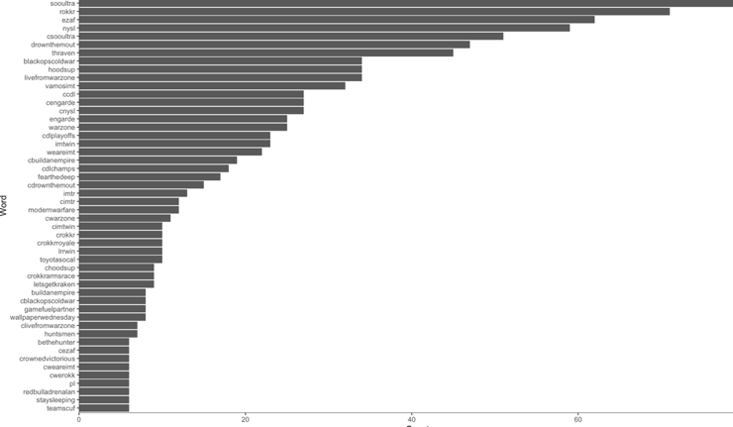
Word Frequency
Word cloud from the original sample, containing all the teams
Most common words:
Team
Soul ultra
Rokkr
Ezzaf
NYLS
Gaming:
Warzone
Drowthemout

Slide 7
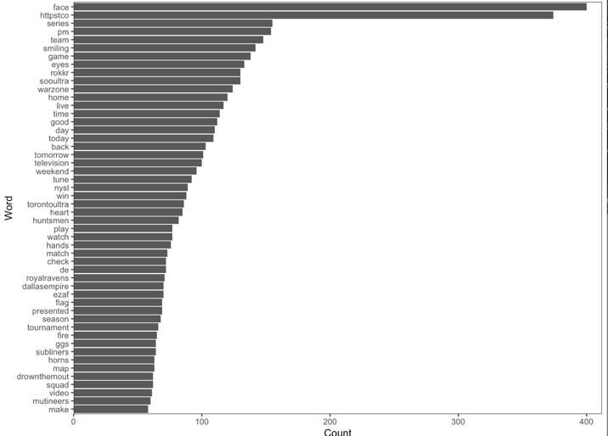
Hashtags word frequency analysis
Word cloud from the original sample, containing all the team's hashtags
More frequent words:
Face
Series
pm
Team Related
Rokkr
Soulultra
nysl
Game related:
Warzone
flag

Slide 8
Word association with: Warzone
We found this word is strongly associated with warzone
Metrobytmobile
Sept
Ruleyourday
august

Slide 9
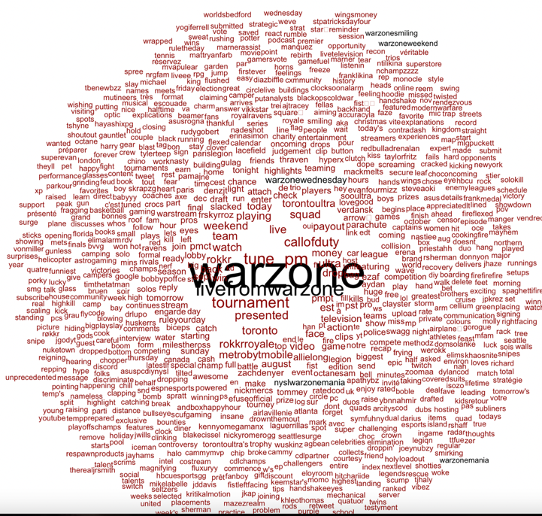
Word Cloud Association
We find some of the words associated with warzone.
Gaming:
Twitch
Tournament
PM
Tune
Sherman
Players:
Zach Denyer
Mile the Ross

Slide 10

Sentiment Analysis
Total Tweets
By team

Slide 11
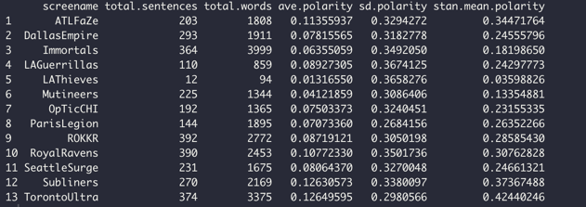
Polarity analysis by team
After running a polarity analysis, we can conclude the following:
Every team has a close polarity to 0, which mean in general, the perception is mainly neutral
The team with the most social media presence are:
Toronto Ultra (most positive polarity)
Rokker
Our analysis will focus on these team and Immortals the has changed names recently and has the most followers

Slide 12
Sentiment Analysis
We start by classifying the words under 3 categories:
Positive
Negative
Neutral
Most words under the positive category, more use word or emoji: smiling face

Slide 13
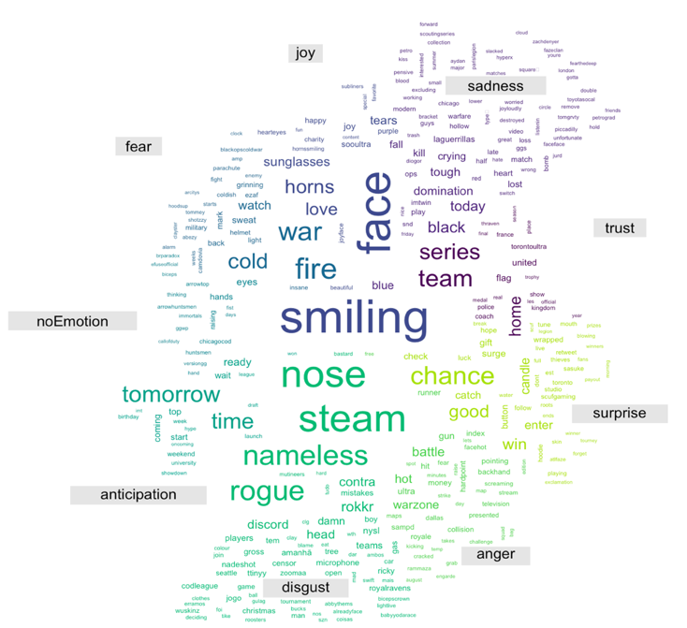
Sentiment Analysis
As a second way to do a sentiment analysis we classified the words into:
Joy
Sadness
Trust
Surprise
Anger
Disgust
Anticipation
Fear
No Emotion
Most words under joy and disgust, more use word or emoji: smiling face, love, nose steam , rogue, nameless

Slide 14


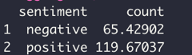
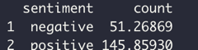
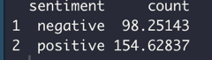

Polarity Analysis by team

Slide 15
Word Frequency Analysis by team
Immortals
ROKKR
Toronto Ultra

Slide 16
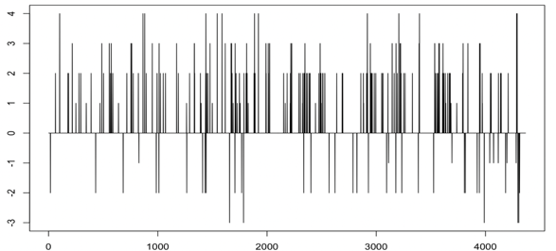
Timeline of Identified Words ( Value Polarity)
ROKKR
Immortals
Toronto Ultra

Slide 17
Sentiment Analysis by team
FamilyID=Office_ArchiveTorn
Toronto Ultra
ROKKR
Immortals

Slide 18
Conclusions
After the word exploratory frequency analysis, we can conclude most of the word refer to the teams, especially Toronto Ultra and Minnesota Rokkr
There is also mention to the main events like Warzone, and the home series which generate a lot of traffic and presence on the social media
On the sentiment analysis we can observe, the polarity is mainly neutral, however this can be due to the lack of a proper dictionary or sense on some game words
When we analyze the sentiment, both type of analysis shows a mainly positive trend, with words related to joy and trust, there is also a part related to disgust. However, this is associated to the competition itself.
On the analysis by team the conclusion is also positive, most words have a positive analysis and with a big trend to express joy.
On the case of introducing a new team to the league, we need to generate competition with main teams, generate positive trends on social media and be part of main events.

Slide 19

THANKS

